Slide 1
UIT2502 – Data Analytics & Visualization
Normal Distribution

Slide 2
Introduction
Overview: Gaussian distribution with bell-shaped curve accurately describes the distribution of values
Purpose: Presents the probability distribution in statistics for independent, random variables

Slide 3
Introduction
The normal distribution is a continuous probability distribution that is symmetrical around its mean
Most of the observations cluster around the central peak
The probabilities for values further away from the mean taper off equally in both directions.
Extreme values in both tails of the distribution are similarly unlikely.
While the normal distribution is symmetrical, not all symmetrical distributions are normal.

Slide 4
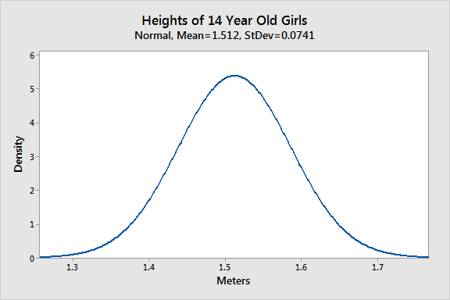
Normally Distributed Data: Heights
Normal Distribution in Statistics - Statistics By Jim

Slide 5
Normally Distributed Data: Heights
The distribution is symmetric. The number of girls shorter than average equals the number of girls taller than average. In both tails of the distribution, extremely short girls occur as infrequently as extremely tall girls.
Normal Distribution in Statistics - Statistics By Jim

Slide 6
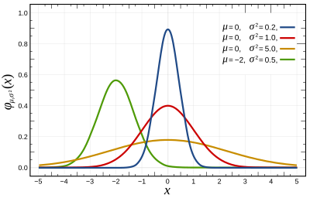
Parameters of normal distribution
Mean and Standard deviation
define its shape and probabilities entirely
The Gaussian distribution does not have just one form

Slide 7
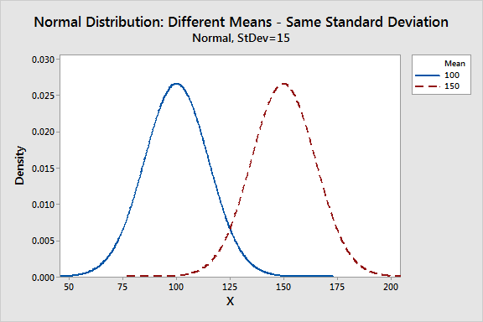
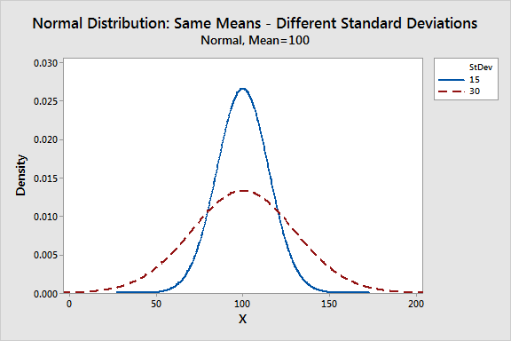
Parameters of normal distribution

Slide 8
Common Properties for Normal Distribution
They’re all unimodal, symmetric bell curves. The Gaussian distribution cannot model skewed distributions.
The mean, median, and mode are all equal.
Half of the population is less than the mean and half is greater than the mean.
The Empirical Rule allows to determine the proportion of values that fall within certain distances from the mean.

Slide 9
Alert
The uniform distribution also models symmetric, continuous data, but all equal-sized ranges in this distribution have the same probability, which differs from the normal distribution.
If continuous data are skewed use Weibull, lognormal, exponential, or gamma distribution.

Slide 10
Empirical Rule for the Normal Distribution
The area under the curve of the normal distribution represents probabilities for the data.
The area under the whole curve is equal to 1, or 100%

Slide 11
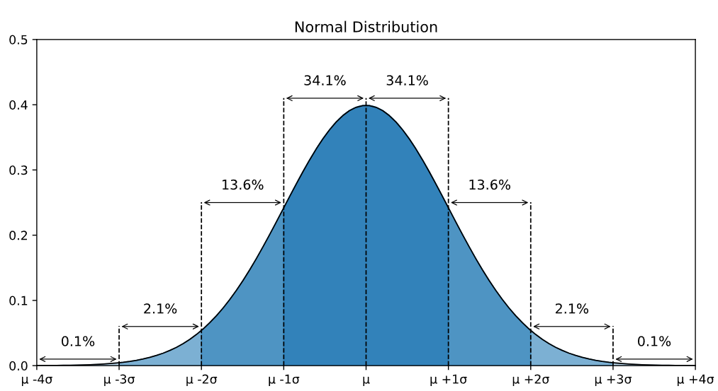
Empirical Rule for the Normal Distribution

Slide 12
Roughly 68.3% of the data is within 1 standard deviation of the average (from μ-1σ to μ+1σ)
Roughly 95.5% of the data is within 2 standard deviations of the average (from μ-2σ to μ+2σ)
Roughly 99.7% of the data is within 3 standard deviations of the average (from μ-3σ to μ+3σ)

Slide 13
Standard Normal Distribution and Standard Scores
A special case of the normal distribution where the mean is zero and the standard deviation is 1.
This distribution is also known as the Z-distribution.
A value on the standard normal distribution is known as a standard score or a Z-score. A standard score represents the number of standard deviations above or below the mean that a specific observation falls.
The mean has a Z-score of 0.

Slide 14
Standard Normal Distribution and Standard Scores
A standard score represents the number of standard deviations above or below the mean that a specific observation falls.
Example:
A standard score of 1.5 indicates that the observation is 1.5 standard deviations above the mean.
On the other hand, a negative score represents a value below the average.

Slide 15
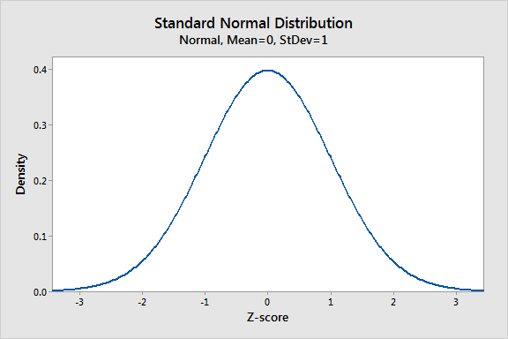
Standard Normal Distribution

Slide 16
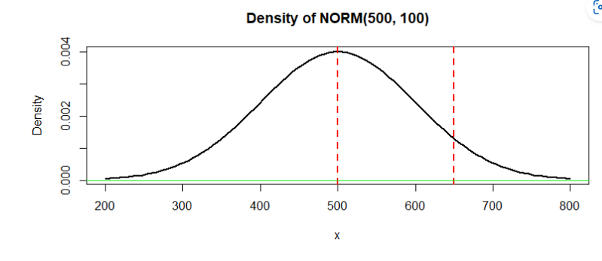
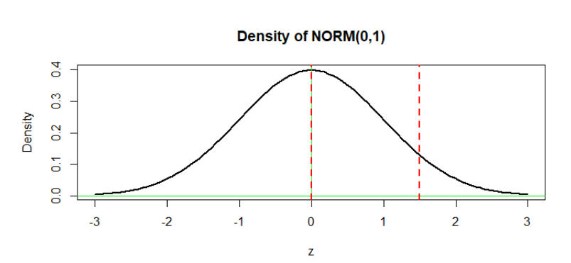
Density
Density: Normalization scale similar to maps (Ex:10K km to 1 Unit)

Slide 17
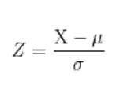
Standardization – Calculating Z-Score
Standard scores are a great way to understand where a specific observation falls relative to the entire normal distribution.
They also allow to take observations drawn from normally distributed populations that have different means and standard deviations and place them on a standard scale.
This standard scale enables to compare observations that would otherwise be difficult.

Slide 18
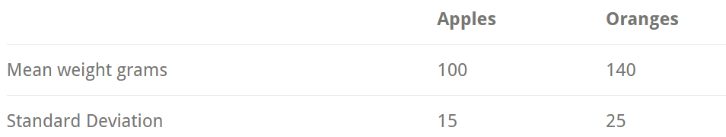
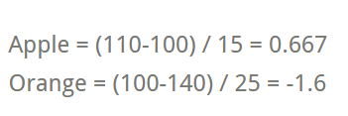
Example
Suppose we literally want to compare apples to oranges. Specifically, let’s compare their weights. Imagine that we have an apple that weighs 110 grams and an orange that weighs 100 grams.
The Z-score for the apple (0.667) is positive, which means that our apple weighs more than the average apple.
The orange has fairly negative Z-score (-1.6). It’s pretty far below the mean weight for oranges

Slide 19
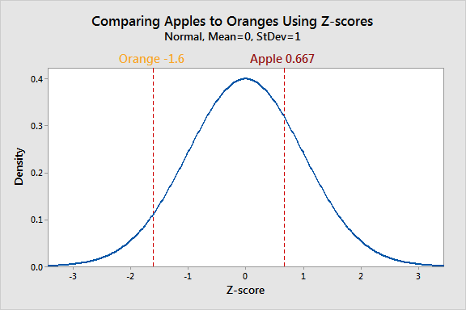
Example

Slide 20
Books
TEXTBOOKS:
David Cielen, Arno D. B. Meysman, and Mohamed Ali, “Introducing Data Science”, Manning Publications, 2016. (first two chapters for Unit I).
Robert S. Witte and John S. Witte, “Statistics”, Eleventh Edition, Wiley Publications, 2017.
Jake VanderPlas, “Python Data Science Handbook”, O’Reilly, 2016.
REFERENCES:
Allen B. Downey, “Think Stats: Exploratory Data Analysis in Python”, Green Tea Press, 2014.

